Slide 1


CS 174A
Discussion-Week 8
2/27/2020

Slide 2
Assignment 4

Slide 3
Assignment 4
We will work out a few exercises that help you become more familiar with how to do assignment 4
Place one cube box of dimension 2x2x2
Translate this box with v=[-2,0,0]
Use the already-defined Phong shader as an argument that is passed for drawing the cube
Now, let’s Implement this functionality for loading a square images of your choice* into texture maps.
Remember, not just any image that you download will work. Images used for texture maps in WebGL 1.0 must be square and have power of two dimensions (therefore only square images of a few limited sizes like 128x128 and 256x256 are valid). WebGL 2.0 doesn't have this limitation but it also isn't widely supported on phones yet so we don't use it.

Slide 4
Assignment 4
We will work out a few exercises that help you become more familiar with how to do assignment 4
Now, let’s Implement this functionality for loading a square images of your choice* into texture maps. Set ambient color to opaque black and ambient coefficient to 1. As a hint:
texture1: context.get_instance( Texture_Rotate ).material( Color.of( 0,0,0,1 ), { ambient: 1, texture: context.get_instance( "assets/wall.jpg", false ) } ),

Slide 5
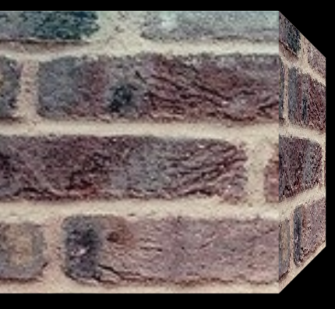
Assignment 4
Your work should look like this up to this point:

Slide 6
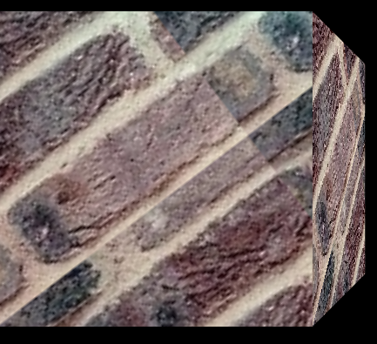
Assignment 4
In this section, modify the shader to rotate the texture continuously. You need to specifically make modifications to :
vec4 tex_color = texture2D( texture, f_tex_coord )

Slide 7
Raytracing

Slide 8
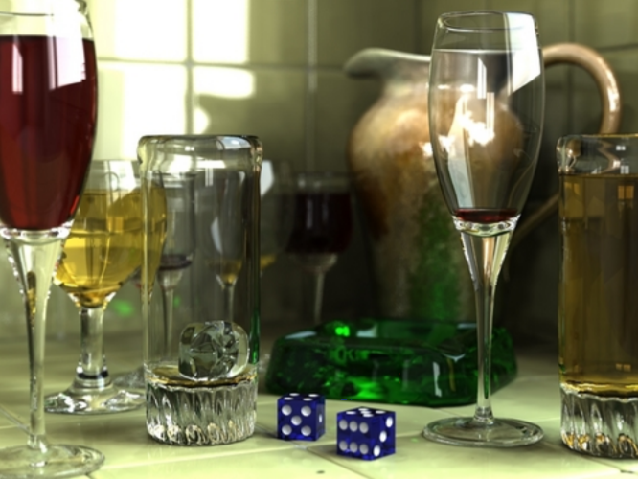
Raytracing
Tracing single rays of light
Partial physical models for determining the ray’s path
Good for point light sources, sharp shadows etc.

Slide 9
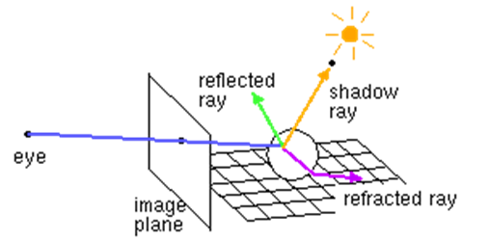
Raytracing
Set up the camera and the image plane
Compute a ray from the eye to every pixel and trace it in the scene
Compute object-ray intersections
Compute shadow, reflected, and refracted rays at each intersection

Slide 10
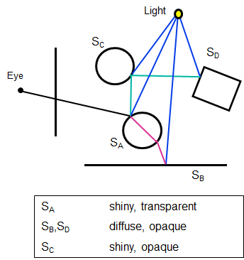
Raytracing
raytrace( ray )
P = closest_intersection(ray) local_color = ShadowRay(light1, P) + … + ShadowRay(lightN, P) reflected_color = raytrace(reflected_ray) refracted_color = raytrace(refracted_ray) color = local_color + + krfl* reflected_color + krfa* refracted_color
return( color )

Slide 11
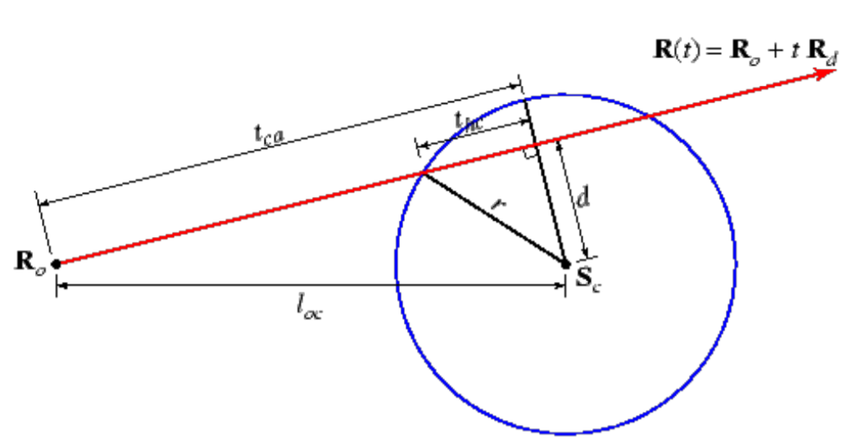
Raytracing
Casting the first ray : P(t)= eye_loc+ t(image_loc-eye_loc)
For each object
Compute the hit time (t)
The one with the lowest t is the hit point
Make simplifications (e.g. bounded volumes)

Slide 12
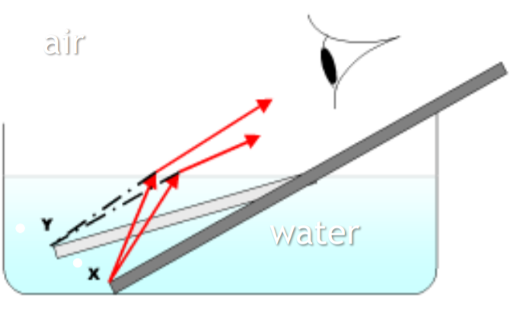
Raytracing
In refraction, light rays that travel from one medium to another are bent
Object at location x seems to be at location y

Slide 13
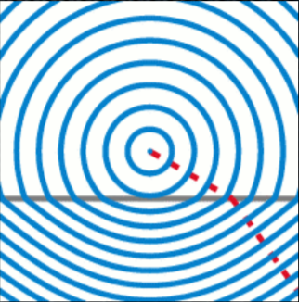
Raytracing
Index of refraction determines how much light is bent
Speed of light depends on the medium itself.
Index of refraction = c/v
c: Speed of light in vacuum: 3*10^(8) m/s
v: Speed of light in the medium of interest
Some typical numbers for index of refraction
Air:1.00029 , Water:1.33 , Acrylic glass: 1.49

Slide 14
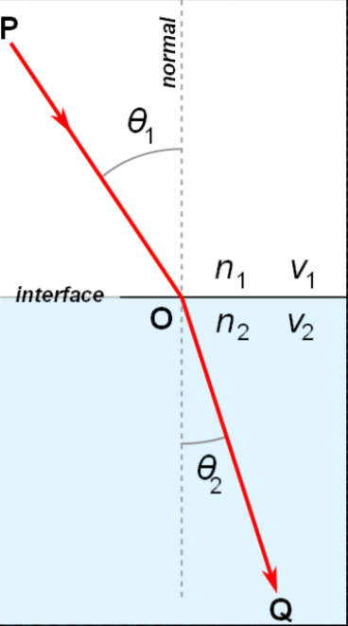
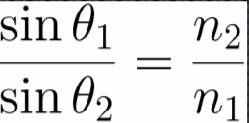
Raytracing
Snell’s law

Slide 15
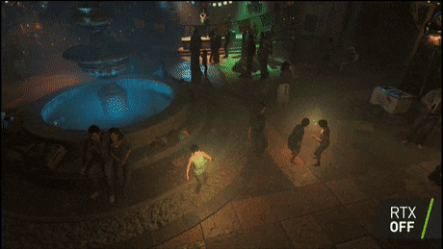
Raytracing
What are some issues with ray tracing ?
It’s computationally expensive ( although we have some advanced these GPUs these days )
Appropriate for modeling point light sources and reflections and retractions but not so ideal for distributed light sources.

Slide 16
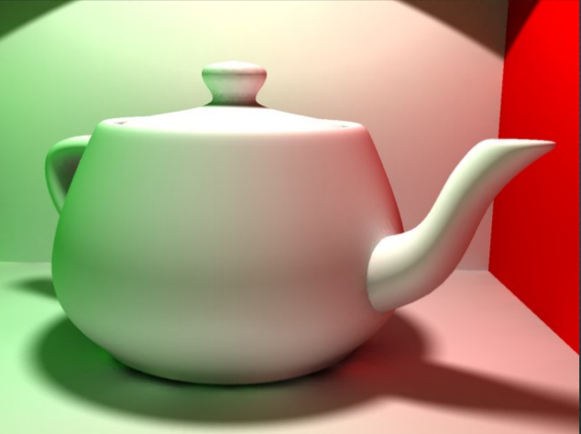
Raytracing
Radiosity is a global illumination model that uses laws of physics and numerical methods (e.g. finite elements) to simulate the distribution of light from a surface
It results in more natural and softer shadows

Slide 17
Raytracing
When an object like a tree is illuminated by the sun, and you are looking toward the tree, light rays leave the object
Only from points at the top and base of the tree, but in every direction.
From every point on the surface of the tree, but only toward your eyes.
Only from points at the top and base of the tree, but only toward your eyes .
From every point on the surface of the tree and in every direction.

Slide 18
Raytracing
A light ray can change direction when going from one material into another. This phenomenon is known as
Refraction
Reflection
Absorption
Scattering

Slide 19
Thank you!

